Slide 1
Python Data Structures (Collection Data Types)
Lists
Tuples
Sets
Dictionaries
LESSON 2-6

Slide 2

Lists
List: Lists are used to store multiple items in a single variable.
Lists are one of 4 built-in data types in Python used to store collections of data,
Others: Tuple, Set, and Dictionary, all with different qualities and usage.
Lists are created using square brackets:

Slide 3
Lists
List Items
List items are ordered, changeable, and allow duplicate values.
List items are indexed, the first item has index [0], the second item has index [1] etc.

Slide 4

Lists
Ordered
When we say that lists are ordered, it means that the items have a defined order, and that order will not change.
If you add new items to a list, the new items will be placed at the end of the list.
Changeable
The list is changeable, meaning that we can change, add, and remove items in a list after it has been created.
Allow Duplicates
Since lists are indexed, lists can have items with the same value:

Slide 5

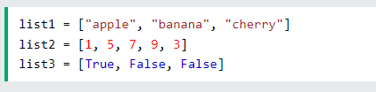

Lists
Length of a list : len() function
__________________________________________________________________________
List Items - Data Types
List items can be of any data type:
You can use keyword type() to check data type

Slide 6
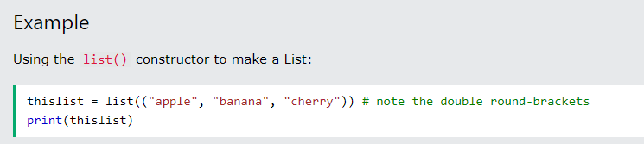
Lists
The list() Constructor
It is also possible to use the list() constructor when creating a new list.

Slide 7
Lists
Accessing List Items
Indexing: Retrieve item in a specific position
Positive Indexing: [0] is the first, [1] the second and so on
Negative Indexing: Start from the end of the list [-1] is the last item, [-2] second last and so on
Slicing : Extract part of a list [start : end (exclude item at this position)]
[: end]
[start : end]
[start:]

Slide 8
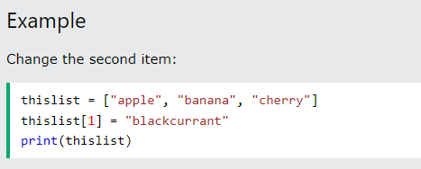
Lists
Change Item Value
To change the value of a specific item, refer to the index number:

Slide 9
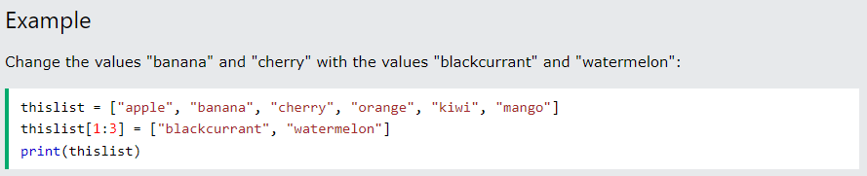
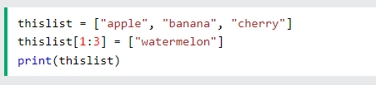
Lists
Change a Range of Item Values
To change the value of items within a specific range, define a list with the new values, and refer to the range of index numbers where you want to insert the new values:
If you insert more items than you replace, the new items will be inserted where you specified, and the remaining items will move accordingly:

Slide 10
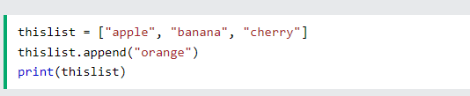

Lists
Append Items
To add an item to the end of the list, use the append() method:
Insert Items
To insert a list item at a specified index, use the insert() method.
The insert() method inserts an item at the specified index:

Slide 11
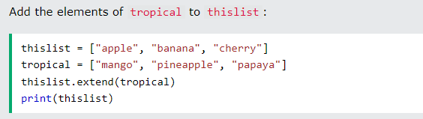
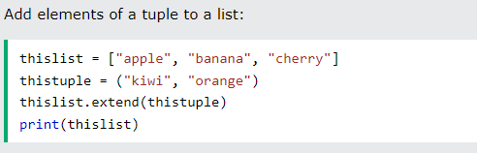
Lists
Extend List
To append elements from another list to the current list, use the extend() method.
Add Any Iterable
The extend() method does not have to append lists, you can add any iterable object (tuples, sets, dictionaries etc.)

Slide 12
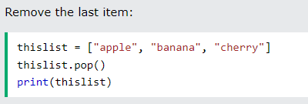
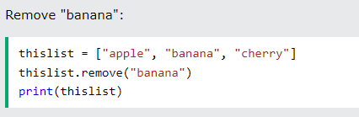
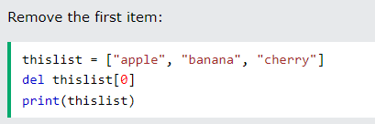
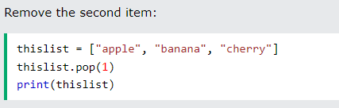

Lists
Remove Specified Item
The remove() method removes the specified item.
If you do not specify the index, the pop() method removes the last item.
The del keyword also removes the specified index:
Remove Specified Index
The pop() method removes the specified index.
The del keyword can also delete the list completely.

Slide 13
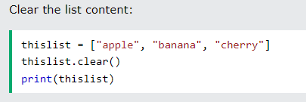
Lists
Clear the List
The clear() method empties the list.
The list still remains, but it has no content.

Slide 14
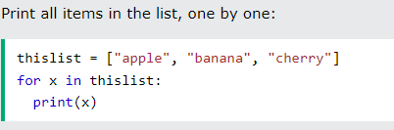
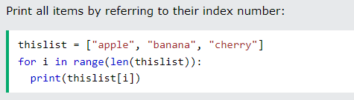
Lists
Loop Through a List
You can loop through the list items by using a for loop:
Loop Through the Index Numbers
You can also loop through the list items by referring to their index number.
Use the range() and len() functions to create a suitable iterable.
The iterable created in the example above is [0, 1, 2].

Slide 15
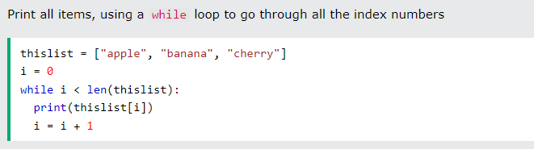
Lists
Using a While Loop
You can loop through the list items by using a while loop.
Use the len() function to determine the length of the list, then start at 0 and loop your way through the list items by referring to their indexes.
Remember to increase the index by 1 after each iteration.

Slide 16
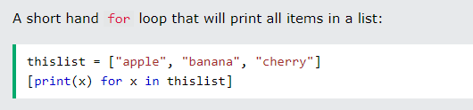
Lists
Looping Using List Comprehension
List Comprehension offers the shortest syntax for looping through lists:

Slide 17
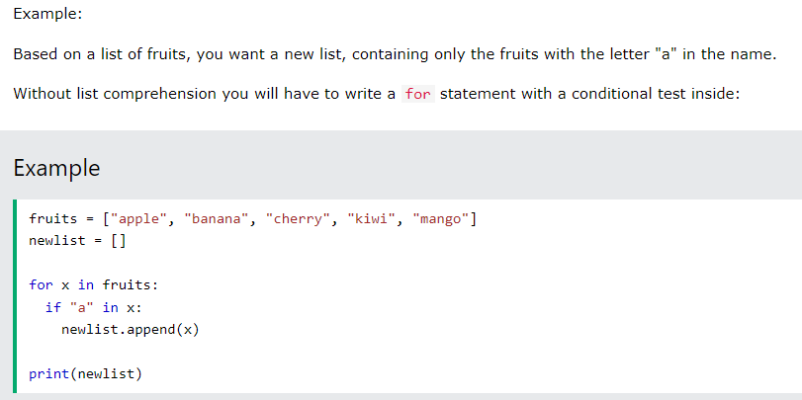
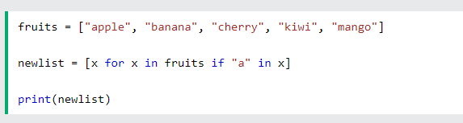
Lists
Looping Using List Comprehension
With list comprehension you can do all that with only one line of code:

Slide 18



Lists
More with List Comprehension

Slide 19
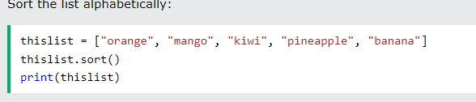
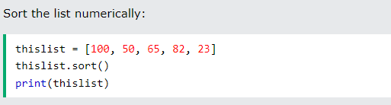
Lists
Sort Lists
Sort List Alphanumerically
List objects have a sort() method that will sort the list alphanumerically, ascending, by default:

Slide 20
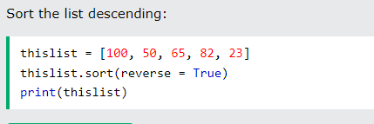
Lists
Sort Lists

Slide 21
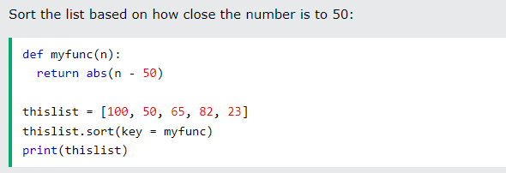
Lists
Sort Lists
Customize Sort Function
You can also customize your own function by using the keyword argument key = function.
The function will return a number that will be used to sort the list (the lowest number first):

Slide 22

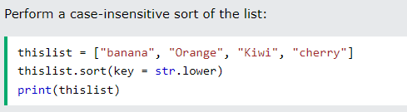
Lists
Sort Lists
Case Insensitive Sorting
By default the sort() method is case sensitive, resulting in all capital letters being sorted before lower case letters:
Case sensitive sorting can give an unexpected result:
if you want a case-insensitive sort function, use str.lower as a key function:

Slide 23
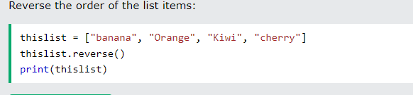
Lists
Sort Lists
Reverse Order
What if you want to reverse the order of a list, regardless of the alphabet?
The reverse() method reverses the current sorting order of the elements.

Slide 24
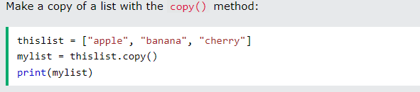
Lists
Copy a List
You cannot copy a list simply by typing list2 = list1, because: list2 will only be a reference to list1, and changes made in list1 will automatically also be made in list2.
There are ways to make a copy, one way is to use the built-in List method copy().

Slide 25
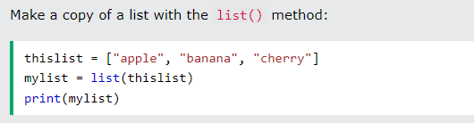
Lists
Copy a List
use the built-in method list().

Slide 26
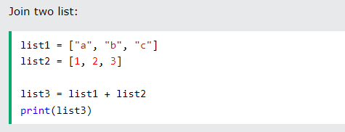
Lists
Join Two Lists
There are several ways to join, or concatenate, two or more lists in Python.
One of the easiest ways are by using the + operator.

Slide 27
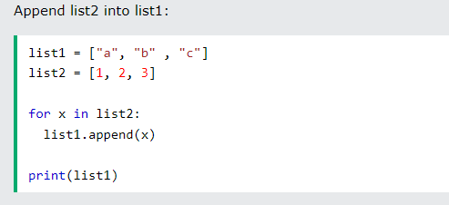
Lists
Join Two Lists
Another way to join two lists is by appending all the items from list2 into list1, one by one:

Slide 28
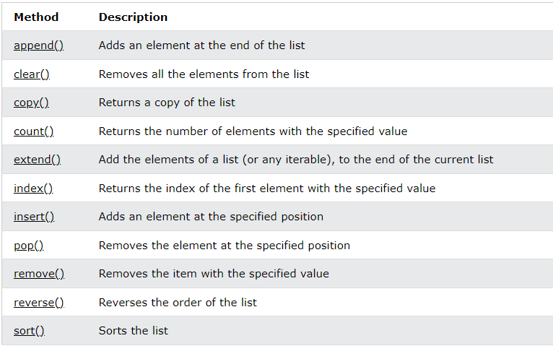
Lists
List methods

Slide 29
TUPLES
Access
Update
Unpack
Loop
Join

Slide 30
TUPLES
Tuples are used to store multiple items in a single variable.
Tuple is one of 4 built-in data types in Python used to store collections of data, the other 3 are List, Set, and Dictionary, all with different qualities and usage.
A tuple is a collection which is ordered and unchangeable.
Tuples are written with round brackets.

Slide 31
TUPLES
Tuple Items
Tuple items are ordered, unchangeable, and allow duplicate values.
Tuple items are indexed, the first item has index [0], the second item has index [1] etc.
Ordered
When we say that tuples are ordered, it means that the items have a defined order, and that order will not change.
Unchangeable
Tuples are unchangeable, meaning that we cannot change, add or remove items after the tuple has been created.
Allow Duplicates
Since tuples are indexed, they can have items with the same value/

Slide 32
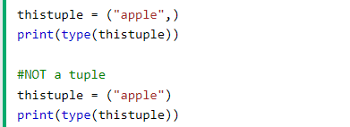


TUPLES
Tuple Length: len()
Tuple with one item: use a coma after the item
Tuple Items - Data Types
Tuple items can be of any data type:
type()
From Python's perspective, tuples are defined as objects with the data type 'tuple':

Slide 33
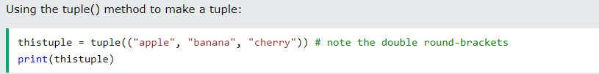
TUPLES
The tuple() Constructor
It is also possible to use the tuple() constructor to make a tuple.

Slide 34

TUPLES
Accessing Tuple Items
Indexing: Retrieve item in a specific position
Positive Indexing: [0] is the first, [1] the second and so on
Negative Indexing: Start from the end of the list [-1] is the last item, [-2] second last and so on
Slicing : Extract part of a list [start : end (exclude item at this position)]
[: end]
[start : end]
[start:]

Slide 35
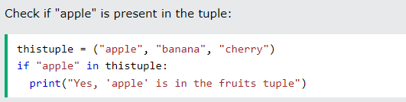
TUPLES
Check if Item Exists
To determine if a specified item is present in a tuple use the in keyword:

Slide 36
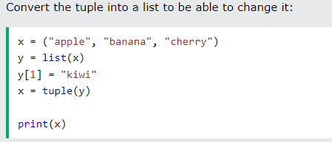
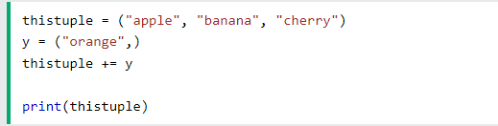
TUPLES
Updating a Tuple
Convert it to list: list keyword
Append item
Convert back to tuple: tuple keyword:
Adding Tuple to Tuple

Slide 37
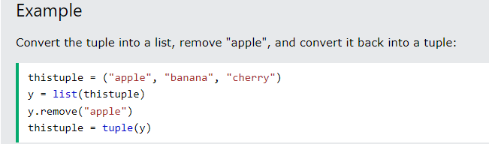
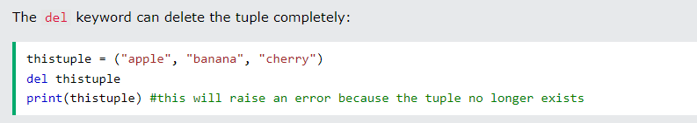
TUPLES
Remove Items: Convert to List, Remove, Convert to Tuple
Delete Tuple: Erase Tuple Completely

Slide 38
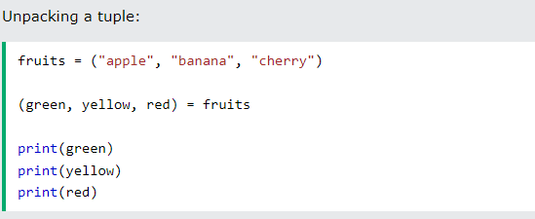
TUPLES
Unpacking tuple: Packing is the creation of a tuple with items/values
In Python, we are also allowed to extract the values back into variables. This is called "unpacking":

Slide 39
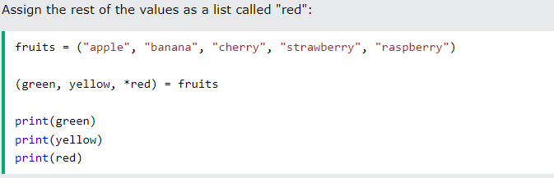
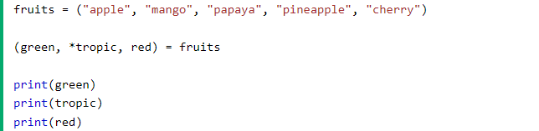
TUPLES
Unpacking tuple:
Using Asterisk*
If the number of variables is less than the number of values, you can add an * to the variable name and the values will be assigned to the variable as a list:

Slide 40

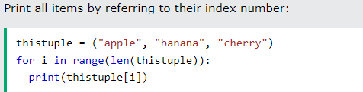
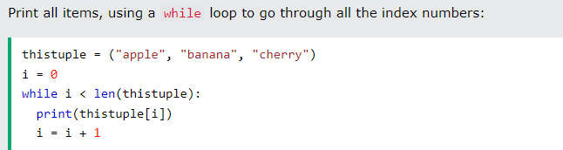
TUPLES
Looping
Refer to Lists

Slide 41
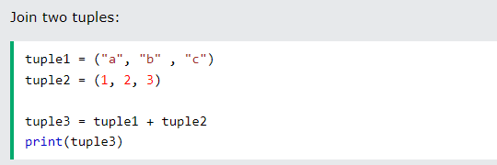
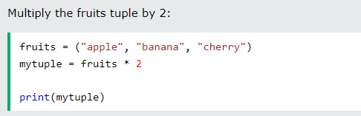
TUPLES
Join Two Tuples:
Refer to Lists

Slide 42
TUPLES
Tuple Methods
Python has two built-in methods that you can use on tuples.
Method | Description
count() | Returns the number of times a specified value occurs in a tuple
index() | Searches the tuple for a specified value and returns the position of where it was found

Slide 43
TUPLES
Advantages of Tuple over List in Python
Since tuples are quite similar to lists, both of them are used in similar situations.
However, there are certain advantages of implementing a tuple over a list:
We generally use tuples for heterogeneous (different) data types and lists for homogeneous (similar) data types.
Since tuples are immutable, iterating through a tuple is faster than with a list. So there is a slight performance boost.
Tuples that contain immutable elements can be used as a key for a dictionary. With lists, this is not possible.
If you have data that doesn't change, implementing it as tuple will guarantee that it remains write-protected.

Slide 44
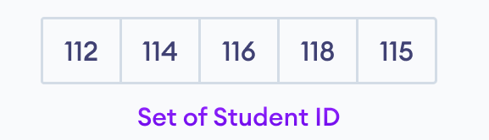
SETS
A set is a collection of unique data. That is, elements of a set cannot be duplicate.
For example,
Suppose we want to store information about student IDs. Since student IDs cannot be duplicate, we can use a set.

Slide 45
SETS
In Python, we create sets by placing all the elements inside curly braces {}, separated by comma.
A set can have any number of items and they may be of different types (integer, float, tuple, string etc.).
But a set cannot have mutable elements like lists, sets or dictionaries as its elements.

Slide 46
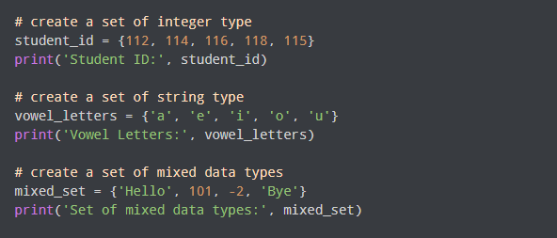
SETS
Example
Note: When you run this code, you might get output in a different order.
This is because the set has no particular order.

Slide 47
SETS
Create an Empty Set in Python
Creating an empty set is a bit tricky.
Empty curly braces {} will make an empty dictionary in Python.
To make a set without any elements, we use the set() function without any argument’.
empty_set = set ()
empty_dictionary = {}

Slide 48

SETS
Item Duplication
Set does not allow duplicates.

Slide 49
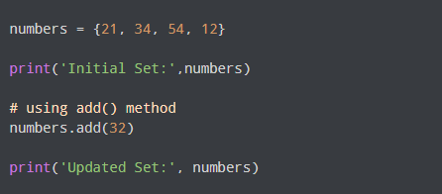
SETS
Add and Update Set Items
Sets are mutable. However, since they are unordered, indexing has no meaning.
We cannot access or change an element of a set using indexing or slicing. Set data type does not support it.
In Python, we use the add() method to add an item to a set. For example:

Slide 50
SETS
Add and Update Set Items
Sets are mutable. However, since they are unordered, indexing has no meaning.
We cannot access or change an element of a set using indexing or slicing. Set data type does not support it.
Add Set Items
In Python, we use the add() method to add an item to a set. For example:

Slide 51
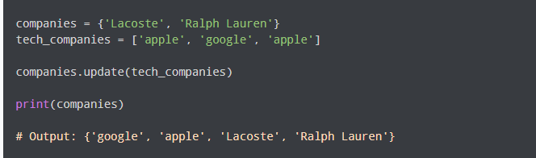
SETS
Update Set Items
The update() method is used to update the set with items other collection types (lists, tuples, sets, etc). For example,
Here, all the unique elements of tech_companies are added to the companies set.

Slide 52
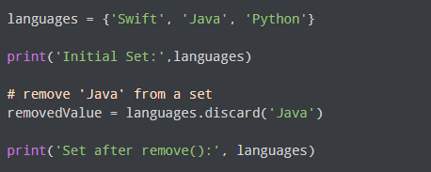
SETS
Remove Set Elements
We use the discard() method to remove the specified element from a set. For example,

Slide 53
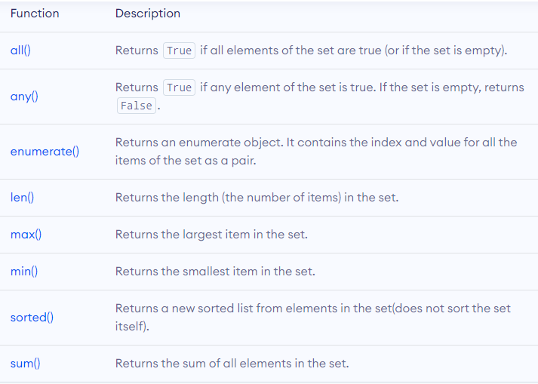
SETS
Built-in
functions

Slide 54


SETS
Iterate over Set Elements
Get Number of Set Elements use len()

Slide 55




SETS
Set Operations:
Union: A | B or A.union(B)
Intersection: A & B or A.intersection(B)
Subtraction: A - B or A.difference(B)
Symmetric Difference: A ^ B or A.symmetric_difference(B)
Set Union
Set Intersection
Set Difference
Set Symmetric Difference

Slide 56

SETS
Check if 2 sets are equal:
We can use the == operator to check whether two sets are equal or not. For example,
A and B have the same elements, so the condition evaluates to True: the order of elements does not matter

Slide 57

SETS
Other Set Methods

Slide 58

SETS
Other Set Methods

Slide 59
PYTHON DICTIONARY
Python dictionary is an ordered collection (starting from Python 3.7) of items.
It stores elements in key/value pairs.
Here, keys are unique identifiers that are associated with each value.

Slide 60

PYTHON DICTIONARY
Example: If we want to store information about countries and their capitals, we can create a dictionary with country names as keys and capitals as values.

Slide 61

PYTHON DICTIONARY
Example: If we want to store information about countries and their capitals, we can create a dictionary with country names as keys and capitals as values.
Keys are "Nepal", "Italy", "England"
Values are "Kathmandu", "Rome", "London"

Slide 62

PYTHON DICTIONARY
Add Elements to a Python Dictionary
We can add elements to a dictionary using the name of the dictionary with []. For example,
We have added a new element with key “Japan” and Value “Tokyo”

Slide 63

PYTHON DICTIONARY
Change Value of Dictionary
We can also use [] to change the value associated with a particular key. For example,

Slide 64

PYTHON DICTIONARY
Accessing Values of a Dictionary
In Python, we use the keys to access their corresponding values. For example,
Here, we have used the keys to access their corresponding values.
Trying to access an key that does not exist, raise a KeyError: value of key

Slide 65

PYTHON DICTIONARY
Removing elements from Dictionary
We use the del statement to remove an element from the dictionary. For example,

Slide 66

PYTHON DICTIONARY
Delete Whole Dictionary
We can also delete the whole dictionary using the del statement,
We are getting an error message because we have deleted the student_id dictionary and student_id doesn't exist anymore.

Slide 67

PYTHON DICTIONARY
Dictionary Membership Test
We can test if a key is in a dictionary or not using the keyword in.
Notice that the membership test is only for the keys and not for the values.

Slide 68

PYTHON DICTIONARY
Iterating Through a Dictionary
We can iterate through each key in a dictionary using a for loop.
Here, we have iterated through each key in the squares dictionary using the for loop and retrieved the associated value

Slide 69

PYTHON DICTIONARY
Dictionary Methods

Slide 70

PYTHON STRINGS
In computer programming, a string is a sequence of characters.
For example, "hello" is a string containing a sequence of characters 'h', 'e', 'l', 'l', and 'o'.
We use single quotes or double quotes to represent a string in Python. For example,

Slide 71

PYTHON STRINGS
Access String Characters in Python
We can access the characters in a string in three ways.
Indexing: One way is to treat strings as a list and use index values. For example,

Slide 72

PYTHON STRINGS
Access String Characters in Python
Negative Indexing: Similar to a list, Python allows negative indexing for its strings. For example:

Slide 73

PYTHON STRINGS
Access String Characters in Python
Slicing: Access a range of characters in a string by using the slicing operator colon :. For example,

Slide 74
PYTHON STRINGS
Access String Characters in Python
Note: If we try to access an index out of the range or use numbers other than an integer, we will get errors.

Slide 75

PYTHON STRINGS
Python Strings are immutable
In Python, strings are immutable. That means the characters of a string cannot be changed. For example,

Slide 76

PYTHON STRINGS
We can Assign New String to String Variable

Slide 77

PYTHON STRINGS
Python Multiline String
We can also create a multiline string in Python. For this, we use triple double quotes """ or triple single quotes '''. For example,

Slide 78

PYTHON STRINGS
Python String Operations
There are many operations that can be performed with strings which makes it one of the most used data types in Python.
1. Compare Two Strings
We use the == operator to compare two strings. If two strings are equal, the operator returns True. Otherwise, it returns False. For example,

Slide 79

PYTHON STRINGS
Python String Operations
2. Join Two or More Strings
In Python, we can join (concatenate) two or more strings using the + operator.

Slide 80

PYTHON STRINGS
Iterate through a String
We can iterate through a string using a for loop. For example,

Slide 81

PYTHON STRINGS
String Length
In Python, we use the len() method to find the length of a string. For example,

Slide 82

PYTHON STRINGS
Membership Test
We can test if a substring exists within a string or not, using the keyword in.

Slide 83

PYTHON STRINGS
Methods
Besides those mentioned above, there are various string methods present in Python. Here are some of those methods:

Slide 84

PYTHON STRINGS
Methods

